Slide 1
Heaps and Priority Queues

Slide 2
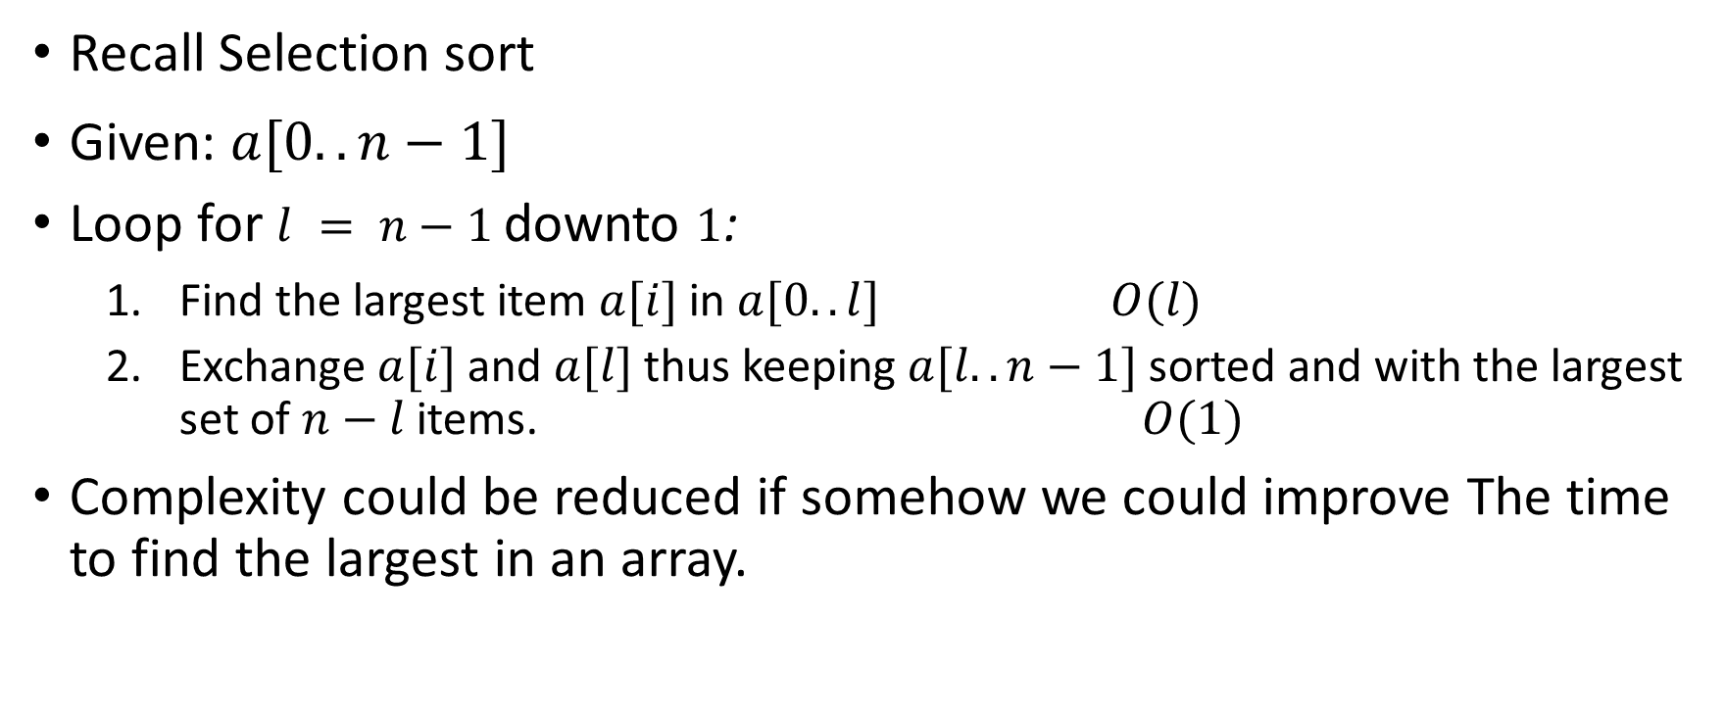
A simple data structure for faster sorting
Recall Selection sort
Given: $a[0..n−1]$
Loop for $l = n−1$downto $1$:
Find the largest item $a[i]$in $a[0..l]$ $O(l)$
Exchange $a[i]$and $a[l]$thus keeping $a[l..n−1]$sorted and with the largest set of $n−l$items. $O(1)$
Complexity could be reduced if somehow we could improve The time to find the largest in an array.

Slide 3
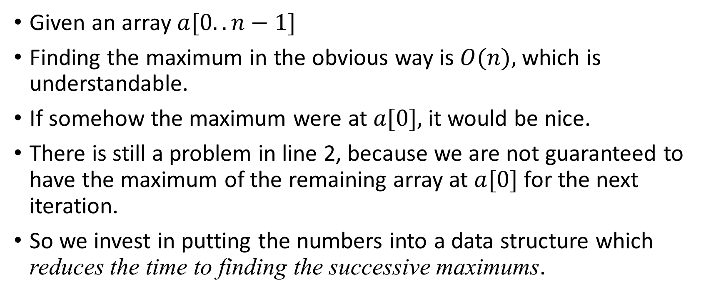
Given an array $a[0..n−1]$
Finding the maximum in the obvious way is $O(n),$which is understandable.
If somehow the maximum were at $a[0],$it would be nice.
There is still a problem in line 2, because we are not guaranteed to have the maximum of the remaining array at $a[0]$for the next iteration.
So we invest in putting the numbers into a data structure which reduces the time to finding the successive maximums.

Slide 4
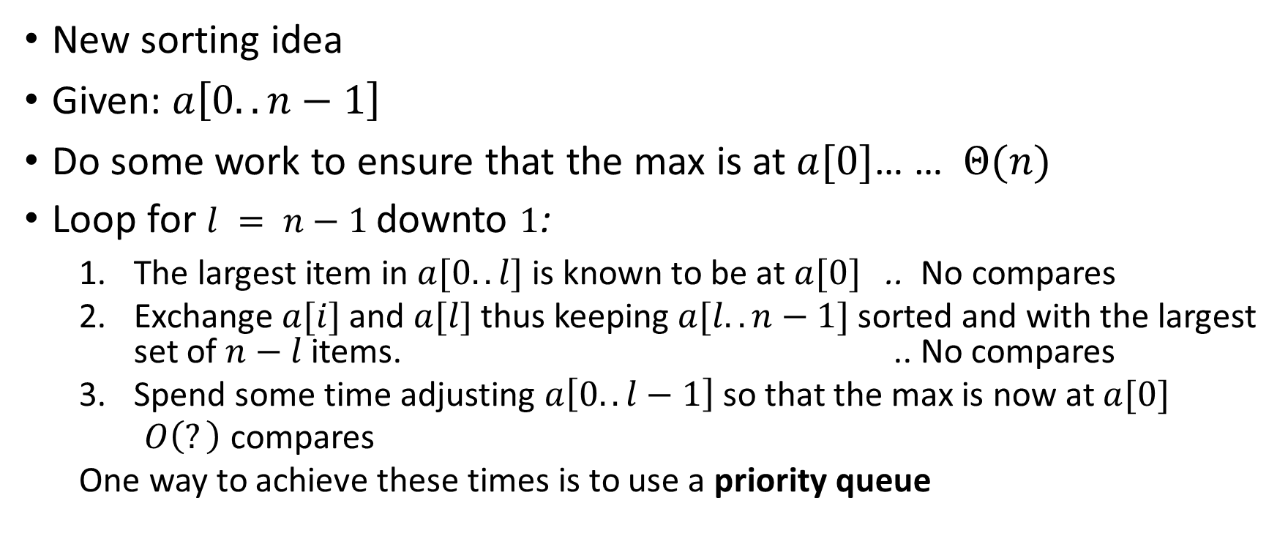
New sorting idea
Given: $a\left[0..n−1\right]$
Do some work to ensure that the max is at $a[0]$… … $Θ(n)$
Loop for $l = n−1$downto $1$:
The largest item in $a[0..l]$ is known to be at $a[0]$ .. No compares
Exchange $a[i]$and $a[l]$thus keeping $a[l..n−1]$sorted and with the largest set of $n−l$items. .. No compares
Spend some time adjusting $a\left[0..l−1\right]$ so that the max is now at $a[0]$
$O\left(?\right)$ compares
One way to achieve these times is to use a priority queue

Slide 5
Pre-work to priority queue: Binary tree
A certain structure with a relationship between ‘nodes’ (positional)
This is a complete binary tree, in the sense that it has no ‘hole’ between the beginning and the end, as seen in a level-wise left to right order.
A
parent
B
C
The binary tree always has an identified root (the only node without a parent)
Left child
D
E
F
G
Right child
H
I
J

Slide 6
Binary tree
A certain structure with a relationship between ‘nodes’
Complete binary tree of n nodes has log(n)+1 levels.
This is a complete binary tree, in the sense that it has no ‘hole’ between the beginning and the end, as seen in a level-wise left to right order.
A
parent
B
C
Depth of a node is number of edges from root to the node
Depth of tree is maximum depth of all nodes
Left child
D
E
F
G
Right child
H
I
J

Slide 7



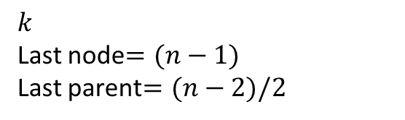

Binary tree → on an array
$$(k−1)/2$$
Parent Computation
$$k$$
Last node$=(n−1)$
Last parent$=(n−2)/2$
A certain structure with a relationship between ‘nodes’
Complete binary tree of n nodes has log(n)+1 levels.
So can be mapped to successive indices in an array
This is a complete binary tree, in the sense that it has no ‘hole’ between the beginning and the end, as seen in a level-wise left to right order.
A
Index $i$
B
C
Index $2i+1$
D
E
F
G
Index $2i+2$
0 1 2 3 4 5 6 7 8 9
H
I
J
int a[10];
A
B
C
D
E
F
G
H
I
J

Slide 8
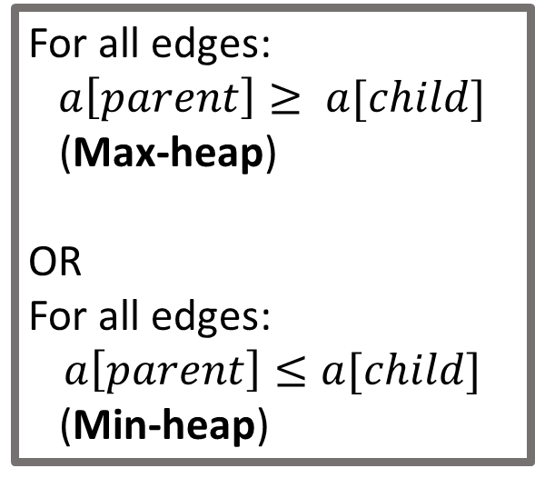
Binary tree → on an array → Heap
A certain structure with a relationship between ‘nodes’
Complete binary tree of n nodes has log(n)+1 levels.
So can be mapped to successive indices in an array
Values are in ‘heap-order’
For all edges: $a\left[parent\right]≥ a[child]$
(Max-heap)
OR
For all edges:
$$a\left[parent\right]≤a[child]$$
(Min-heap)
A
Index $i$
B
C
Index $2i+1$
D
E
F
G
Index $2i+2$
0 1 2 3 4 5 6 7 8 9
H
I
J
int a[10];
A
B
C
D
E
F
G
H
I
J

Slide 9

An Example Heap
A certain structure with a relationship between ‘nodes’
Complete binary tree of n nodes has log(n)+1 levels.
So can be mapped to successive indices in an array
Values are in ‘heap-order’
For all edges: $a\left[parent\right]≥ a[child]$
(Max-heap)
OR
For all edges:
$$a\left[child\right]≤a[parent]$$
(Min-heap)
42
Index $i$
32
9
Index $2i+1$
25
30
3
2
0 1 2 3 4 5 6 7 8 9
Index $2i+2$
int a[10];
42
32
9
25
30
3
2
7
1
6
7
1
6

Slide 10
More about the heap (max-heap)
Fixing an ‘almost’ heap
Only the root is out of order wrt its children.
The idea is to bubble it down along the path of the larger child recursively
Stop if no need to bubble down
This is called a heap-down operation heap_down(0,n) operation
8
32
9
25
30
3
2
7
1
6

Slide 11
More about the heap (max-heap)
Bubble-down(0,n)
8
32
9
25
30
3
2
7
1
6

Slide 12
More about the heap (max-heap)
Bubble-down(1,n)
32
8
9
25
30
3
2
7
1
6

Slide 13
More about the heap (max-heap)
No need to bubble-down() at 4
Clearly number of bubble-down steps are at most equal to depth of the binary tree
32
30
9
25
8
3
2
7
1
6

Slide 14

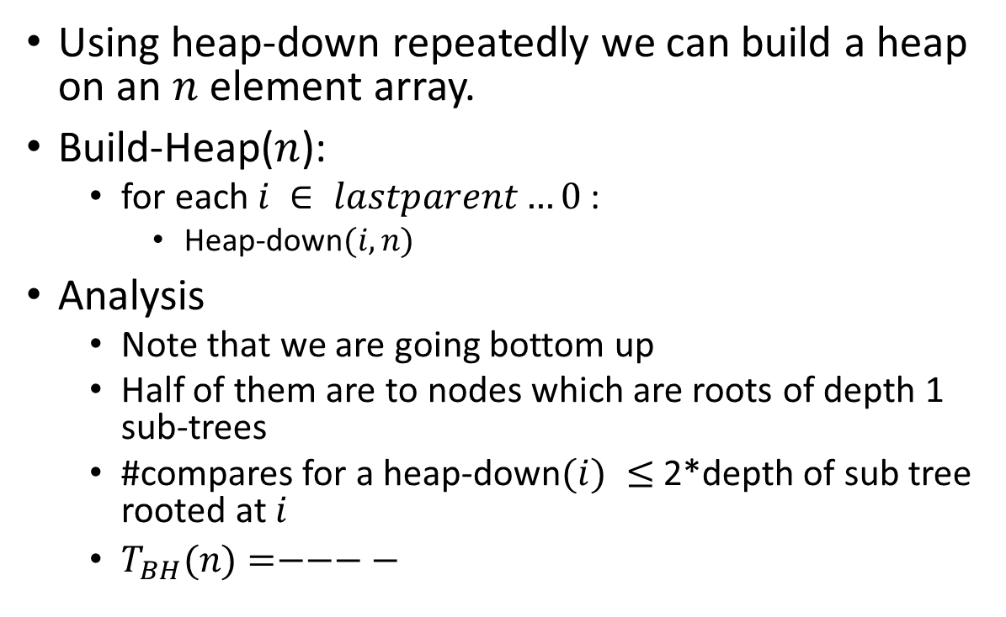



Build-heap
Using heap-down repeatedly we can build a heap on an $n$ element array.
Build-Heap($n$):
for each $i ∈ lastparent…0$ :
Heap-down$(i,n)$
Analysis
Note that we are going bottom up
Half of them are to nodes which are roots of depth 1 sub-trees
#compares for a heap-down$(i) ≤$ 2*depth of sub tree rooted at $i$
$T_{BH}(n)=−−−−$
…
$$n/16$$
$3$
2
1
$$n/8$$
$$n/4$$
…
#nodes
Depth of subtree

Slide 15
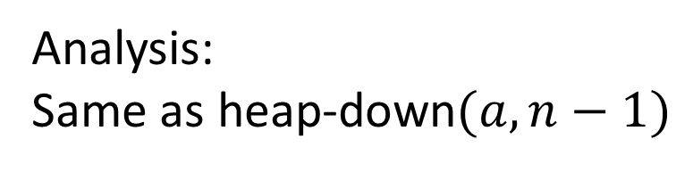
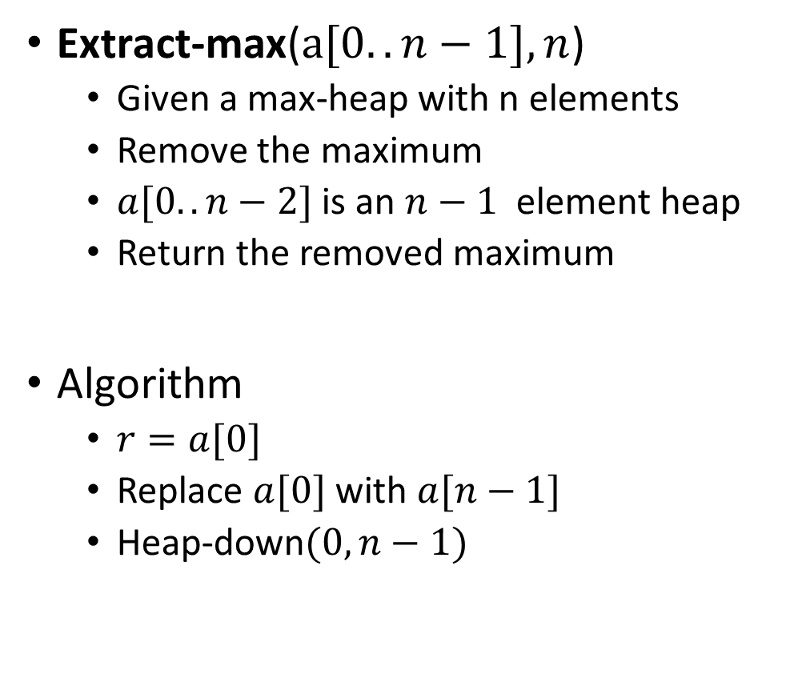
More about the heap (max-heap)
32
30
9
Extract-max($a[0..n−1], n$)
Given a max-heap with n elements
Remove the maximum
$a[0..n−2]$is an $n−1$ element heap
Return the removed maximum
Algorithm
$r=a[0]$
Replace $a[0]$with $a[n−1]$
Heap-down$(0,n−1)$
25
8
3
2
7
1
6
Analysis:
Same as heap-down$(a,n−1)$

Slide 16
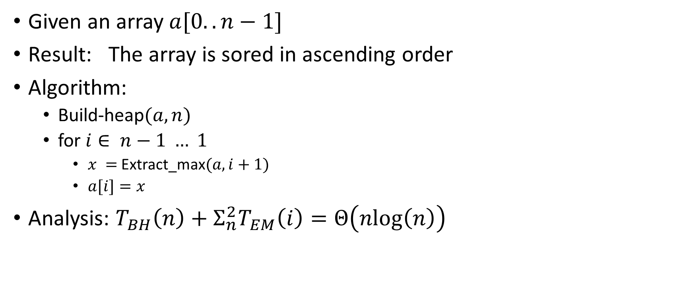
HeapSort
Given an array $a[0..n−1]$
Result: The array is sored in ascending order
Algorithm:
Build-heap$(a,n)$
for $i∈ n−1 … 1$
$x =$Extract_max$(a,i+1)$
$a[i]=x$
Analysis: $T_{BH}\left(n\right)+Σ_{n}^{2}T_{EM}\left(i\right)=Θ\left(nlog\left(n\right)\right)$

Slide 17
Priority queue
A priority queue supports, minimally
Create(q) (create a new queue, possibly from a given set of elements)
Insert(q) (insert a new item into an existing priority queue)
Extract_max(q) (remove the maximum priority element from the priority queue and return the value)
Here priority happens to be the value of the element.
How do we insert in a binary heap? Analysis ?
What about building a heap by successive inserts ? Analysis?
Binary heap is an example of a priority queue
Heap is a useful data structure in some other algorithms as well, eg graph algorithms.

